Slide 1
Introduction to SQL: Structured Query Language
By AppJedi
Day Three
Friday December 26, 2024

Slide 2
Review Syllabus.
Goals:
Basic SELECT statement for data retrieval.
Where clause filter rows.
Using wild cards.
Specifying columns and column aliases.
Order by (Sorting).
Limiting number of rows.
SQL Operators: Arithmetic, Comparison, Logical
SQL Null Functions:
Set Operations: UNION, UNION ALL, INTERSECT, EXCEPT
Sub queries.
Primary & Foreign Keys
Joins: INNER, LEFT, RIGHT, SELF, OUTER.
Aggregates: COUNT, SUM, AVG, MIN, MAX.
Group By and Having (filter).
Temp tables (with)
CASE statements.
Views.
Date functions.
String functions.
Numeric Functions.
Stored Procedures.

Slide 3
Sub-Queries:
An SQL Subquery, is a SELECT query within another query. It is also known as Inner query or Nested query and the query containing it is the outer query.
Sub Query Can used in Column List, FROM, JOIN and WHERE clause

Slide 4
Sub Query IN example (WHERE)
SELECT * FROM customer
WHERE id IN (
SELECT customerID
FROM `order`);

Slide 5
Sub Query NOT IN example
SELECT * FROM customer
WHERE id NOT IN (
SELECT customerID
FROM `order`);
Exercise: Try the above query with different columns, tables.

Slide 6
Sub Query EXISTS example:
The EXISTS operator is used to test for the existence of any record in a subquery.
The EXISTS operator returns TRUE if the subquery returns one or more records.
SELECT * FROM products
WHERE EXISTS(SELECT 1 FROM products WHERE RegularPrice>100)
SELECT * FROM products
WHERE NOT EXISTS(SELECT 1 FROM products WHERE RegularPrice>100)

Slide 7
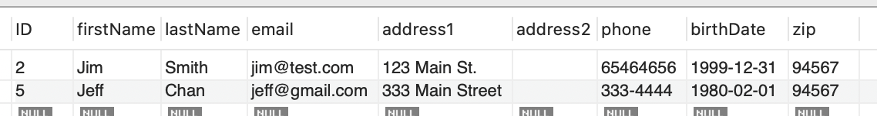
Compound Sub Query
SELECT * FROM customer
WHERE (lastName, firstName) IN (SELECT lastName, firstName FROM customer_new);

Slide 8
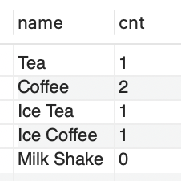
Correlated Subqueries as Column
Correlated subqueries are used for row-by-row processing. Each subquery is executed once for every row of the outer query.
SELECT p.name,(SELECT COUNT(*) FROM orderLine ol
WHERE ol.productID = p.id) AS cnt
FROM product p;

Slide 9
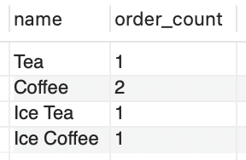
SubQuery in FROM
SELECT p.name, oc.order_count
FROM product p,
(SELECT productID, COUNT(*) AS order_count FROM orderLine ol GROUP BY productID
) AS oc
WHERE oc.productID = p.id

Slide 10
JOINS:
(INNER) JOIN: Returns records that have matching values in both tables
LEFT (OUTER) JOIN: Returns all records from the left table, and the matched records from the right table
RIGHT (OUTER) JOIN: Returns all records from the right table, and the matched records from the left table
FULL (OUTER) JOIN: Returns all records when there is a match in either left or right table
SELF JOIN: Join that combines the records of a table with itself
FULL JOIN: creates a new table by joining two tables as a whole. The joined table contains all records from both the tables and fills NULL values for missing matches on either side. In short, full join is a type of outer join that combines the result-sets of both left and right joins.

Slide 11
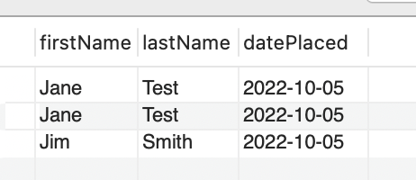
INNER JOIN
SELECT customer.firstName, customer.lastName, orders.datePlaced
FROM customer
JOIN orders ON customer.ID = orders.customerId
ORDER BY lastName DESC, firstName;

Slide 12
SubQuery in JOIN
SELECT p.name, oc.order_count
FROM (SELECT productID, COUNT(*) AS order_count FROM orderLine ol GROUP BY productID) oc
JOIN product p ON oc.productID = p.id

Slide 13
Primary & Foreign Keys:
Primary Key: Column or columns that uniquely identify a row in a table. Best Practice is single column, integer and auto-generated by the database.
Foreign Key: Primary key of another table that links 0 to many rows in foreign key table to one row in the primary key table.
All of the tables in the database have ID as a key.
Best Practice is joins are based on primary/foreign key join.

Slide 14
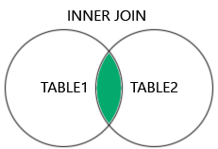

[INNER] JOIN
SELECT lastName, firstName, datePlaced
FROM customer c
JOIN `order` o ON c.id = o.customerID;
INNER is optional. You write the query as INNER JOIN or JOIN

Slide 15
Multiple Joins
SELECT c.id AS CustomerId, c.lastName, c.firstName, o.datePlaced, o.id AS orderId, ol.productId,p.name AS productName, p.currentPrice,ol.quantity
FROM customer c
JOIN orders o ON c.id = o.customerID
JOIN orderLine ol ON o.id = ol.orderId
JOIN product p ON ol.productId=p.id

Slide 16

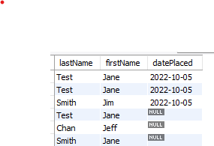
LEFT JOIN
SELECT lastName, firstName, datePlaced
FROM customer c
LEFT JOIN orders o ON c.id = o.customerID;

Slide 17

RIGHT JOIN
SELECT lastName, firstName, datePlaced
FROM customer c
RIGHT JOIN `order` o ON c.id = o.customerID;

Slide 18
RIGHT JOIN
SELECT lastName, firstName, datePlaced
FROM `order` o
RIGHT JOIN customer c ON c.id = o.customerID;

Slide 19
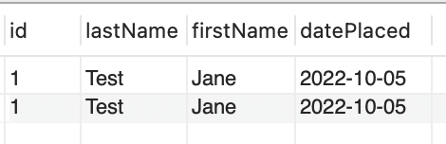
INNER JOIN WITH WHERE CLAUSE
SELECT lastName, firstName, datePlaced
FROM customer c
JOIN orders o ON c.id = o.customerID
WHERE c.id=1;

Slide 20
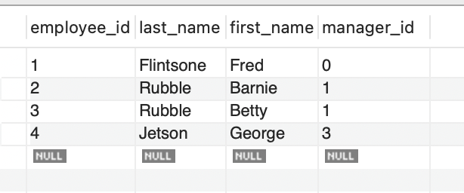
SELF JOIN
JOINing a. table to itself.
Example: using employee table:

Slide 21
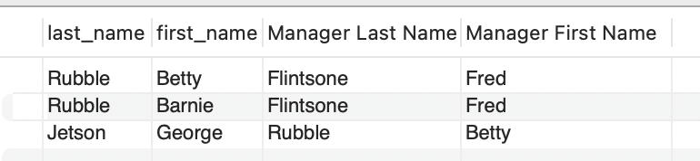
SELF JOIN example cont.
SELECT e.last_name, e.first_name, m.last_name AS 'Manager Last Name', m.first_name AS 'Manager First Name'
FROM employees e
JOIN employees m ON e.manager_Id = m.employee_Id;
Note when joining a table to itself you must use table aliases, i.e. employees e and employees m

Slide 22
FULL OUTER JOIN
A full outer join is a type of SQL join that combines the results of a left join and a right join. It returns all records from both tables, matching rows where there is a match between the two tables' keys and including NULLs where no match is found.
Key Points:
Matching Rows: Where a match exists between the two tables, rows are combined.
Non-Matching Rows: Rows with no match in either table are included in the result, with NULLs for the missing columns.
Result: The result includes:
  All rows from the left table.
  All rows from the right table.
  Combined rows where a match exists.

Slide 23
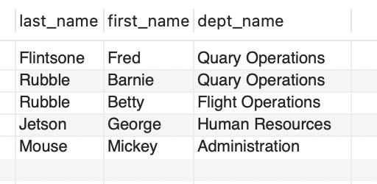
FULL JOIN Example:
SELECT last_name, first_name, dept_name
FROM employees e
FULL JOIN departments d ON e.dept_id = d.dept_id;

Slide 24
HR Department Report
SELECT dept_name, m.last_name AS 'Manager Last Name', m.first_name AS 'Manager First Name',
e.last_name AS 'Employee Last Name', e.first_name AS 'Employee First Name'
FROM employees m
LEFT JOIN departments d ON m.dept_Id = d.dept_Id
LEFT JOIN employees e ON e.manager_id = d.manager_id
UNION – work around for full outer join.
SELECT dept_name, m.last_name AS 'Manager Last Name', m.first_name AS 'Manager First Name',
e.last_name AS 'Employee Last Name', e.first_name AS 'Employee First Name'
FROM employees m
RIGHT JOIN departments d ON m.dept_id = d.dept_id
RIGHT JOIN employees e ON e.manager_id = d.manager_id

Slide 25
Thank You!
Leave your questions in the comment section.
Please like and subscribe to my channel.
Find me online at www.appjedi.net

